Slide 1



Software engineering (Undergraduate)
Chapter 7 feature driven development (fdd)
Course Name software engineering
CSC 3114
(Undergraduate)
M. Mahmudul hasan
Assistant Professor, CS, AIUB
http://www.dit.hua.gr/~m.hasan

Slide 2
History of fdd
Slide-2
Original Creator: Jeff De Luca
Singapore in late 1997
FDD evolved from an actual project
Bank Loan Automation
Luca was Project manager
50 member developer team
MMH

Slide 3
What is fdd?
Slide-3
Feature Driven Development (FDD)
FDD is an agile software development process
FDD uses a short-iteration model
FDD combines key advantages of other popular agile approaches along with other industry-recognized best practices
FDD was created to easily scale to much larger projects and teams
MMH

Slide 4
What is a feature?
Slide-4
FDD delivers the system feature by feature
Feature is a small function expressed in client-valued terms which presents the customer requirements to be developed in software using small iteration
Features are to be “small” in the sense they will take no more than two weeks to complete Features that appear to take longer are to be broken up into a set of smaller features. Two weeks is the maximum, most features take less time (1 - 5 days)
Feature naming template:
<action> the <result> <by|for|of|to> a(n) <object>
Examples: Calculate the total of a sale Validate the password of a user Authorize the sales transaction of a customer
MMH

Slide 5
Class ownership
Slide-5
Class (feature) assigned to specific developer
Class owner responsible for all changes in implementing new features
Collective Ownership
Any developer can modify any artifact at any time
Advantages of Class Ownership are:
Someone responsible for integrity of each class
Each class will have an expert available
Class owners can make changes much quicker
Easily lends to notion of code ownership (XP)
MMH

Slide 6
Fdd roles
Slide-6
FDD Primary Roles
FDD Supporting Roles
Project Manager | Chief Architect
Class Owners | Domain Experts
 | Chief Programmers
Language Guru (shared vocabulary)
Toolsmith (making tools for application)
Tester
Technical Writer (documentation)
MMH

Slide 7
Fdd process
Slide-7
Process #1: Develop an Overall Model
Process #2: Build a Features List
Process #3: Plan By Feature
Process #4: Design By Feature
Process #5: Build By Feature
MMH

Slide 8
Fdd process
Slide-8
Project wide upfront design activities:
Process #1: Develop an Overall Model
Process #2: Build a Features List
Process #3: Plan By Feature
Goal: not to design the system in its entirety but instead is to do just enough initial design that you are able to build on
Deliver the system feature by feature:
Process #4: Design By Feature
Process #5: Build By Feature
Goal: Deliver real, completed, client-valued function as often as possible
MMH

Slide 9
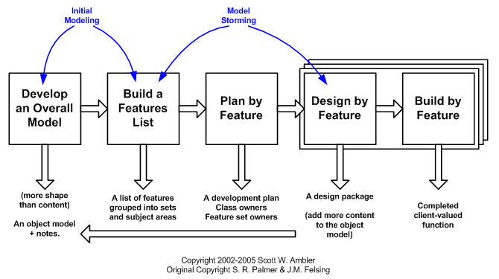
Fdd process
Slide-9
MMH

Slide 10
Fdd process
Slide-10
Process #1: Develop an Overall Model
Form a modeling team
Domain walk-through
Build High-level object model
Record Notes
Goal - for team members to gain a good, shared understanding of the problem domain and build a foundation
Process #2: Build a Features List
All Features are organized in a three level hierarchy :
Domain Subject Area
Business Activity
Features
MMH

Slide 11
Fdd process
Slide-11
Process #3: Plan by Feature
Construct initial schedule
Formed on level of individual features
Prioritize by business value
Also consider dependencies, difficulty, and risks
Assign responsibilities to team members
Determine Class Owners
Assign feature sets to chief programmers
MMH

Slide 12
Fdd process
Slide-12
Process #4: Design by Feature
Form Feature Teams
Team members collaborate on the full low level analysis and design
Certain features may require teams to bring in domain experts
Teams need to update the model artifact to support their changes
Feature Team
Chief Programmers pick teams based on the current feature in development
Chief Programmers lead picked team (usually 3 to 5 people)
Upon completion of the current feature the team disbands
Each team will concurrently work on their own independent iteration
Possible to be on multiple teams at once
MMH

Slide 13
Fdd process
Slide-13
Process #5: Build by Feature
Implement designed feature
Test feature
Unit-level
Feature-level
Mandated Code Inspections (formal review with checklist)
Integrate with regular build
MMH

Slide 14
Fdd process
Slide-14
Mandated Code Inspections for Two Main Reasons
Research has shown that when it is done properly, inspections find more bugs as well as different types of bugs than any other form of testing.
It is also a great learning experience
Reporting
FDD emphasizes the ability to provide accurate, meaningful, and timely progress information to all stakeholders within and outside the project
Feature Milestones
MMH

Slide 15
references
Slide - 15
R.S. Pressman & Associates, Inc. (2010). Software Engineering: A Practitioner’s Approach.
Kelly, J. C., Sherif, J. S., & Hops, J. (1992). An analysis of defect densities found during software inspections. Journal of Systems and Software, 17(2), 111-117.
Bhandari, I., Halliday, M. J., Chaar, J., Chillarege, R., Jones, K., Atkinson, J. S., & Yonezawa, M. (1994). In-process improvement through defect data interpretation. IBM Systems Journal, 33(1), 182-214.

